Slide 1






Aurora
COMPETITIONS
مسابقات اليوم الهندسي
مسابقة الذكاء الاصطناعي

Slide 2
OUTLINES
Problem Statement
Demo Showcase
Our Solution
What’s next?
AI Applications

Slide 3



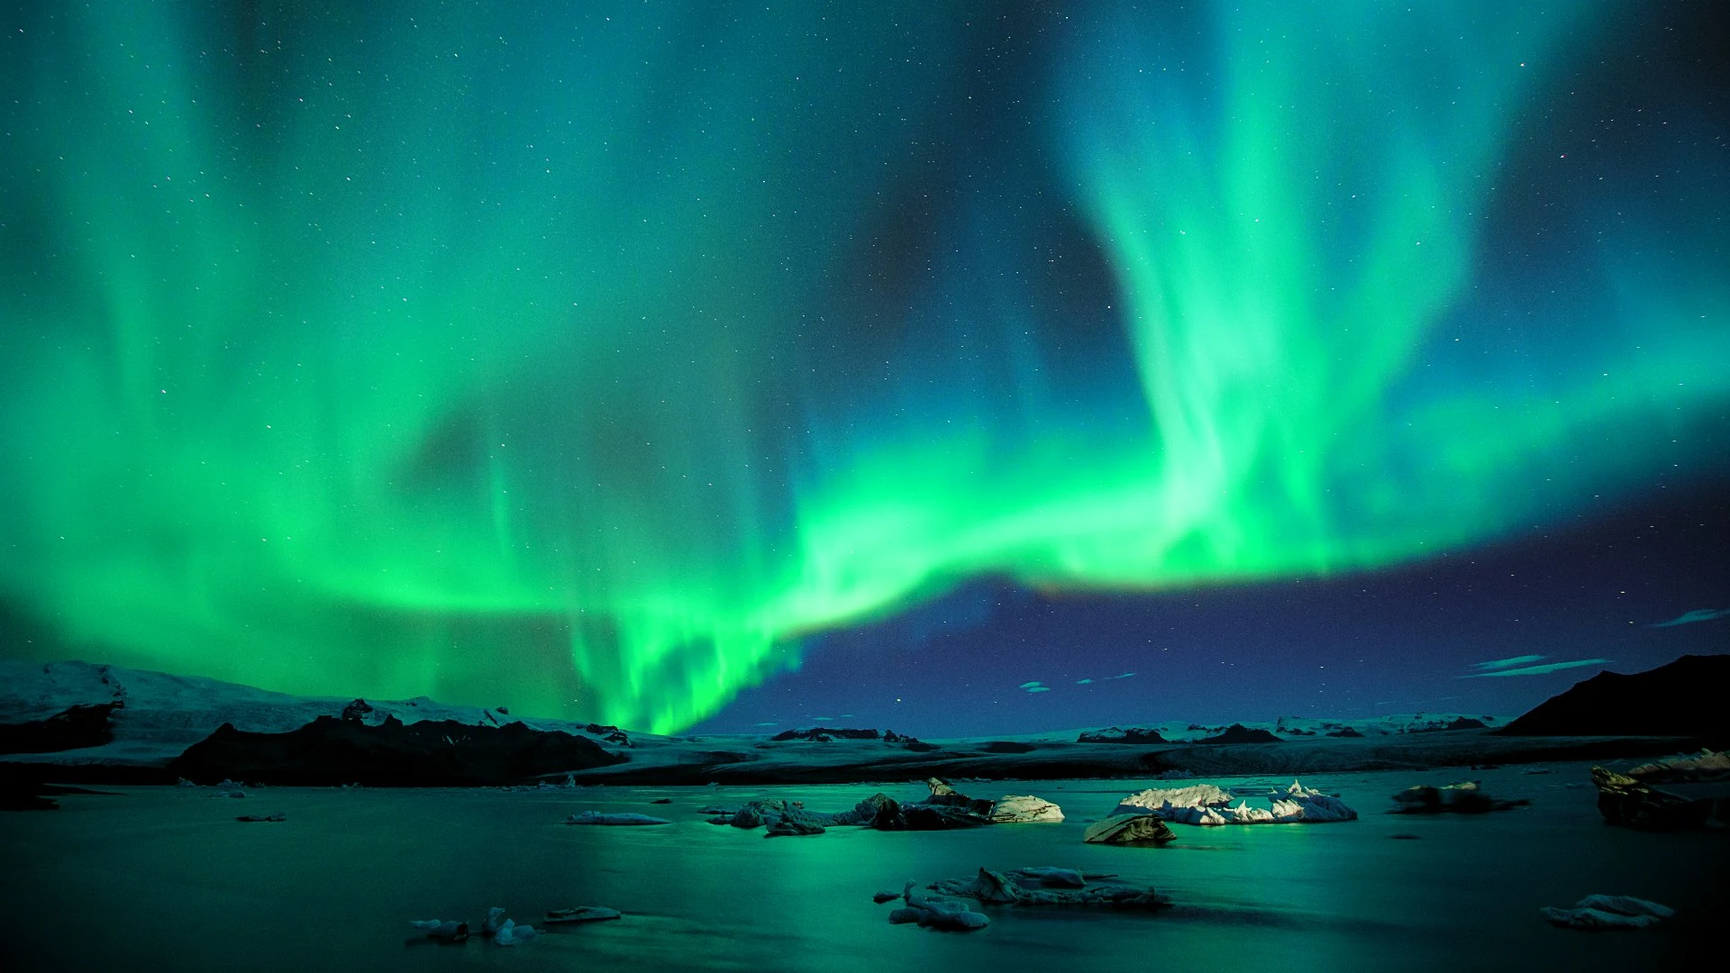
Problem Statement
Travel planning is time-consuming and overwhelming, requiring users to manually research, schedule, and optimize their trips.
Time
consuming
Overwhelming
choices
Finding desired locations

Slide 4
Our Solution
An AI-powered platform that generates a complete trip schedule with a click of a button.
Complete trip planner
Personal voiced tour
Easy-to-use Interface
Tailored for Saudi Arabia

Slide 5



AI Applications
Prompt Engineering to find the best places and schedule the timings.
Voices your story for the scheduled trips.

Slide 6

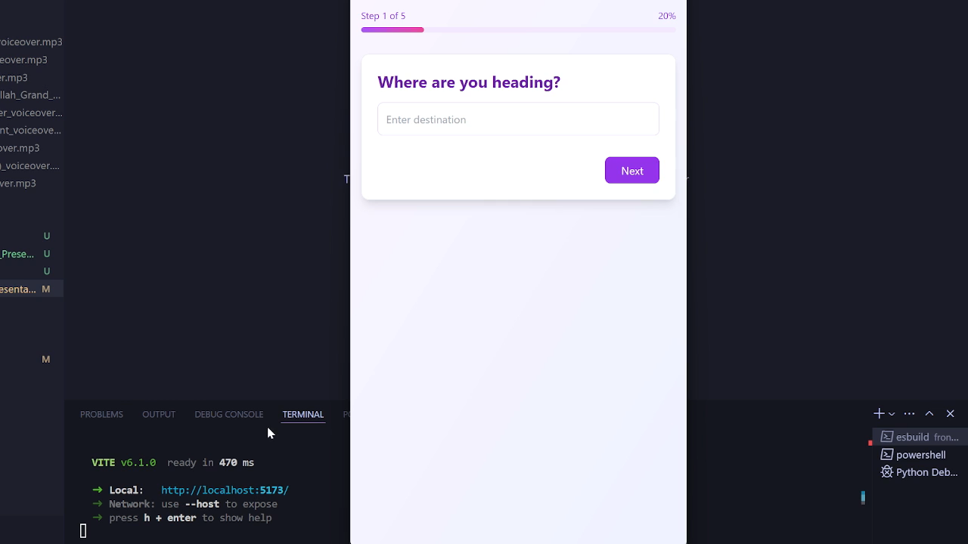
Demo
Showcase

Slide 7
What’s Next?
Improving User Experience
Calendar Integration
A Mascot Guide

Slide 8



Our Team
HJHJHJ;K’;K’[
Omar Ghazal
Backend Developer
Umair Thasleem
Frontend Developer
Abdulmohsen Saleh
Backend Developer

Slide 9



COMPETITIONS
مسابقات اليوم الهندسي
Thank you...
#اليوم _الهندسي_2025

